Slide 1

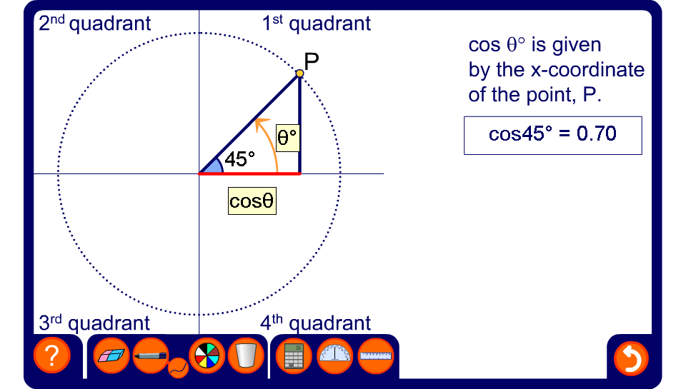


The cosine of any angle
Notes:
Explain that cos θ is given by the x-coordinate of the point P. This is shown by the length of the bold orange line.
Slowly, drag the point P through 360°, starting at 0° and ending at 360°. Observe the length of the line representing the x-coordinate of the point P as it is rotated. Point out that when the line is in the first and the fourth quadrants, that is, when θ is between 0° and 90° or between 270° and 360° (also between 0° and –90°), it is to the right of the y-axis and therefore positive. When the line representing cos θ is in the second and third quadrants, that is, when θ is between 90° and 270°, it is to the left the y-axis and therefore negative. In other words, the cosine of angles between 90° and 270°, is negative.
In this activity, P can be moved through any angle between –360° and 720°. Demonstrate the cosine of these angles if required. Explain that P can be moved through any positive or negative angle in this way.
Focusing on angles between 0° and 180° (that is, angles in the first and second quadrants) demonstrate the relationships between pairs of angles that have the same cosine, but are of opposite sign. For example, show that cos 148° = –cos 32°. Conclude that cos θ = –cos (180° – θ).
Focus next on angles between 180° and 270° (that is, angles in the third quadrant) . Show that cos θ = – cos (θ – 180°).
In the fourth quadrant, examine angles between 270° and 360° and between 0° and –90°. Conclude that cos θ = cos (360° – θ) for angles between 270° and 360° and cos θ = cos –θ for angles between 0° and –90°.

